Slide 1
Data Analysis Using Spark SQL
By: Kritika goel

Slide 2
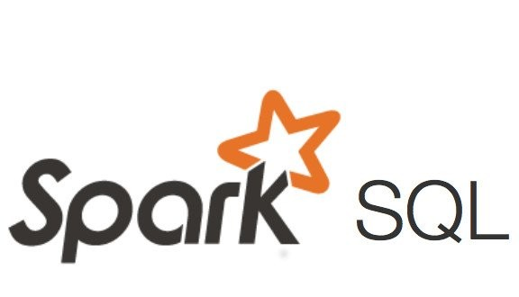
Project Statement
Implement Data analysis using Spark SQL on Azure Databricks & Process data for errors, Seasonality, and Anomalies.

Slide 3
Project Requirements
Data Ingestion
Data Exploration
Data Cleaning
Data Analysis with Spark SQL
Error Detection
Seasonality Analysis
Anomaly Detection
Visualization

Slide 4
OVERVIEW
The main aim of this project is to demonstrate how data analysis can be performed using SparkSql and how we can process data for errors, anomalies and seasonalities in Azure DataBricks. In this the key points would be:
Data Analysis with Spark SQL
Error Processing
Anomaly Detection
Seasonality Analysis

Slide 5
Azure Resources used
Azure Data Lake Storage Gen2:Here the raw data is uploaded in CSV format.
Azure Databricks: It is used for data transformations.We run various SparkSQL command to do data cleaning and transforming.
SparkSQL: SparkSQL is a component of Apache Spark that provides a programming interface for structured and semi-structured data

Slide 6
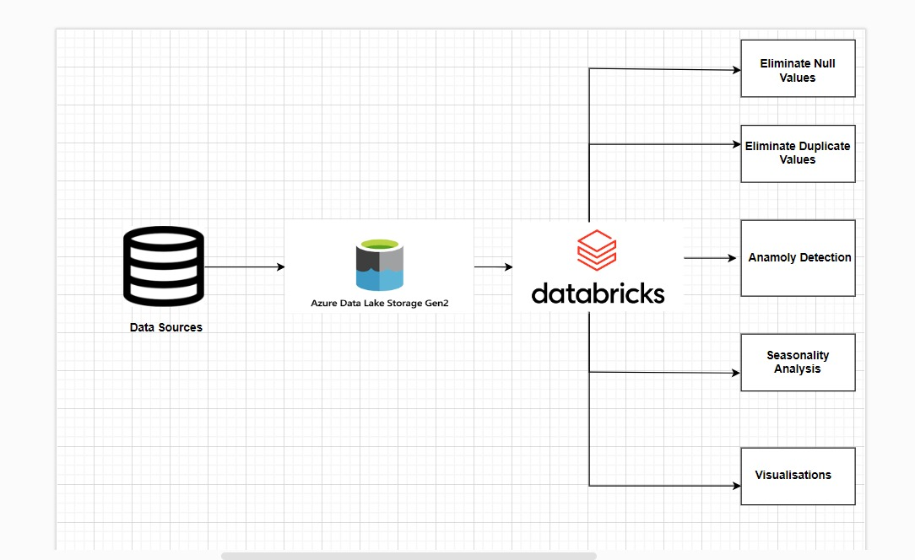
WORKFLOW
Setting up Azure DataBricks Workspace
Connecting Data Source to Azure DataBricks
Running SparkSQL queries for:
Data Analysis
Error Handling
Anomaly Detection
Seasonality Analysis

Slide 7
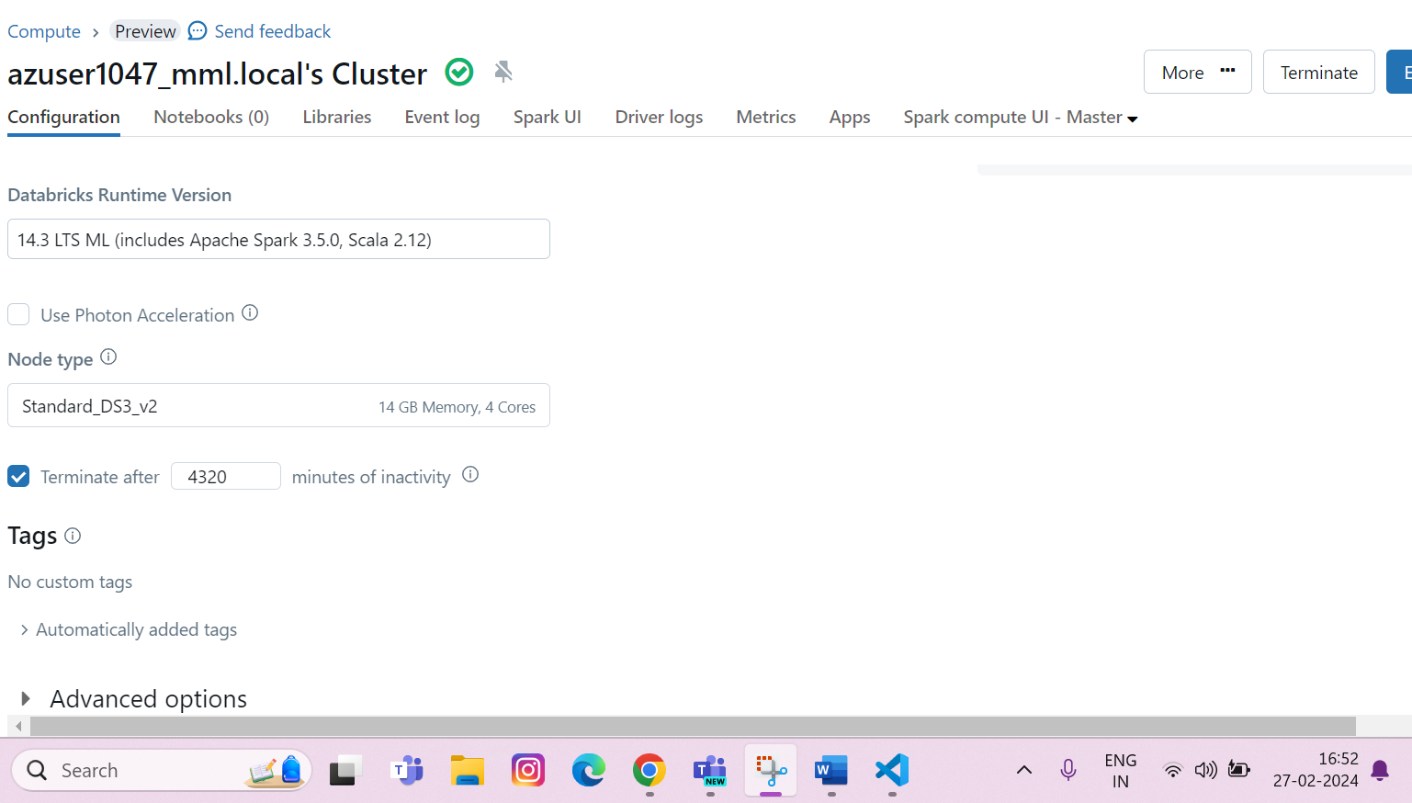
Setting Up DataBricks
In the Azure Portal create a new Databricks.
Once, successfully deployed Launch the DataBricks
Create a new cluster in it and set up the parameters as required.
Create a workspace connected to the cluster.

Slide 8
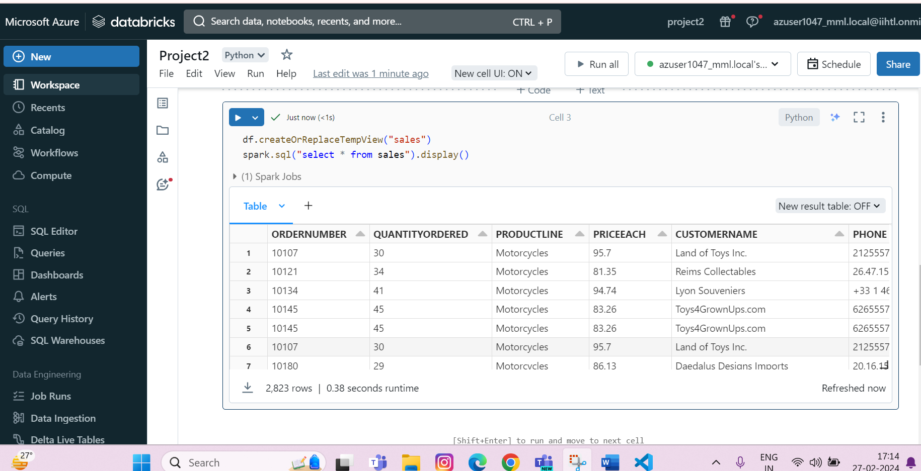
Data Analysis
Using SparkSQL queries start analysing your data: Read your data, try to figure out errors or sesaonalities that may need to be resolved.

Slide 9
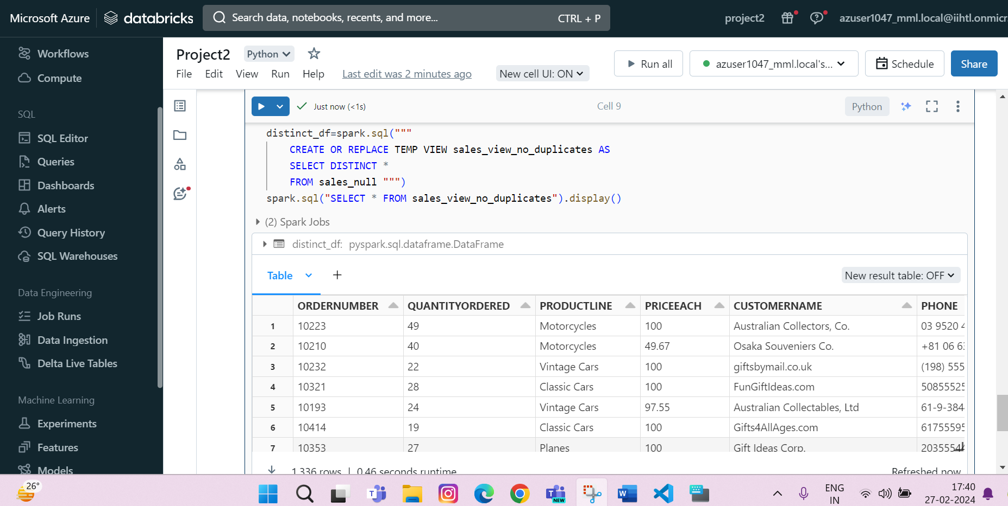
Error Handling
Perform Error Handling with SparkSql Queries like removing duplicate values.

Slide 10
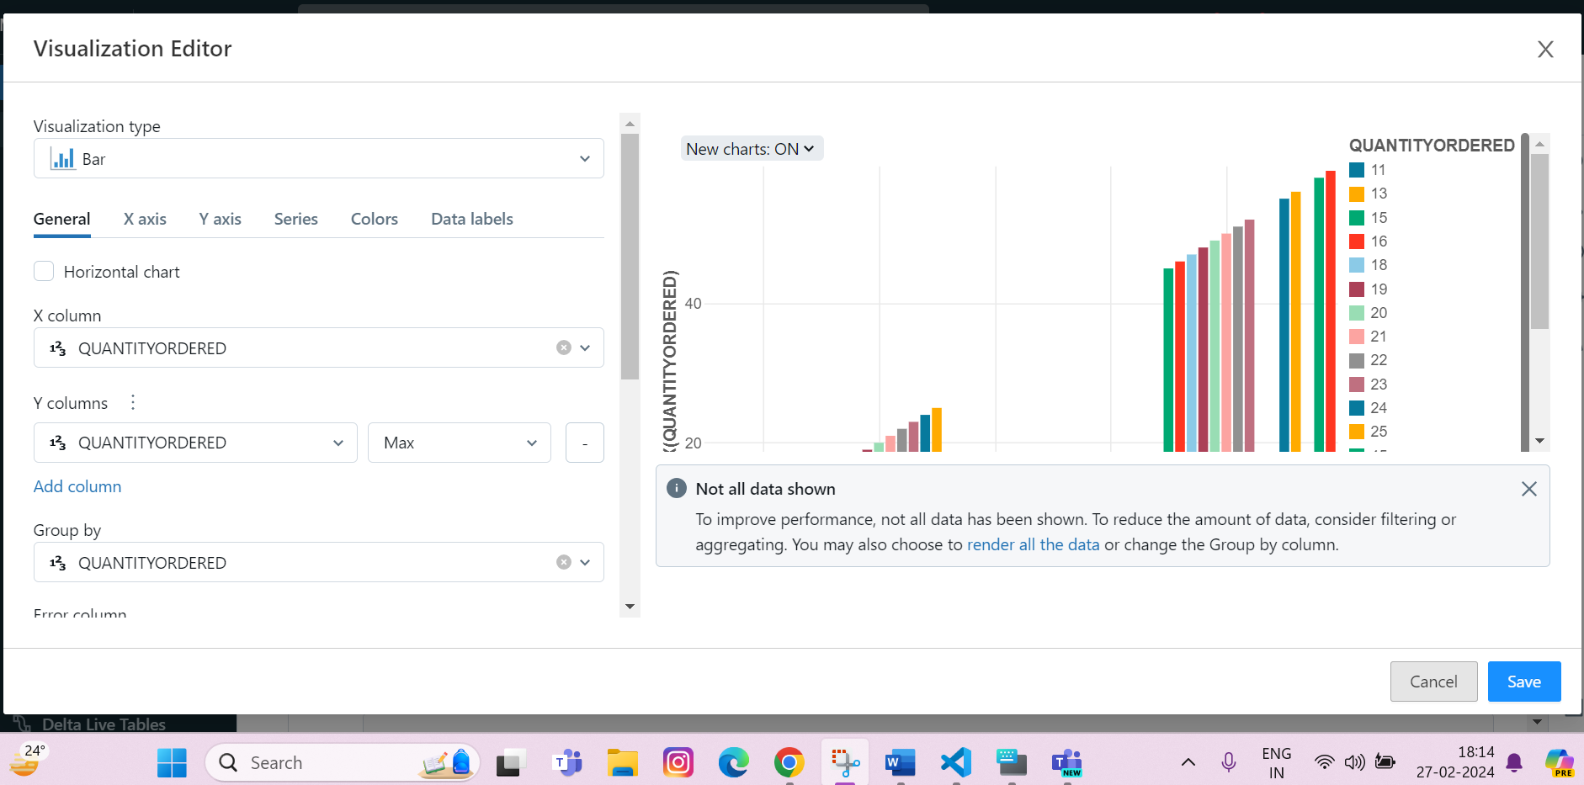
Anomaly Detection
Perform Anomaly Detection in your dataset through SparkSQL queries.
Perform Anomaly Detection in dataset through SparkSQL queries by calculating z-score.
Steps:
Calculate Z-scores for each value
Define anomaly threshold (e.g., Z-score greater than 1)
Analyse the identified anomalies.
Visualization of Anomalies (e.g., scatter plot of ORDERDATE vs. QUANTITYORDERED)

Slide 11
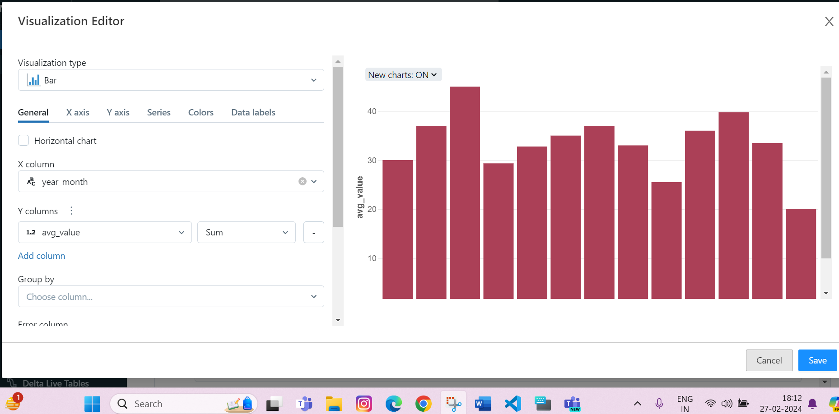
Seasonality Analysis
Analyse the data for seasonality patterns using Spark SQL.
Apply time series analysis techniques such as moving averages to identify recurring fluctuations over time.
Steps:
Apply moving average to smooth out seasonal variations.
Analyse Moving Averages.
Visualize Moving Averages in Azure Data Bricks.

Slide 12
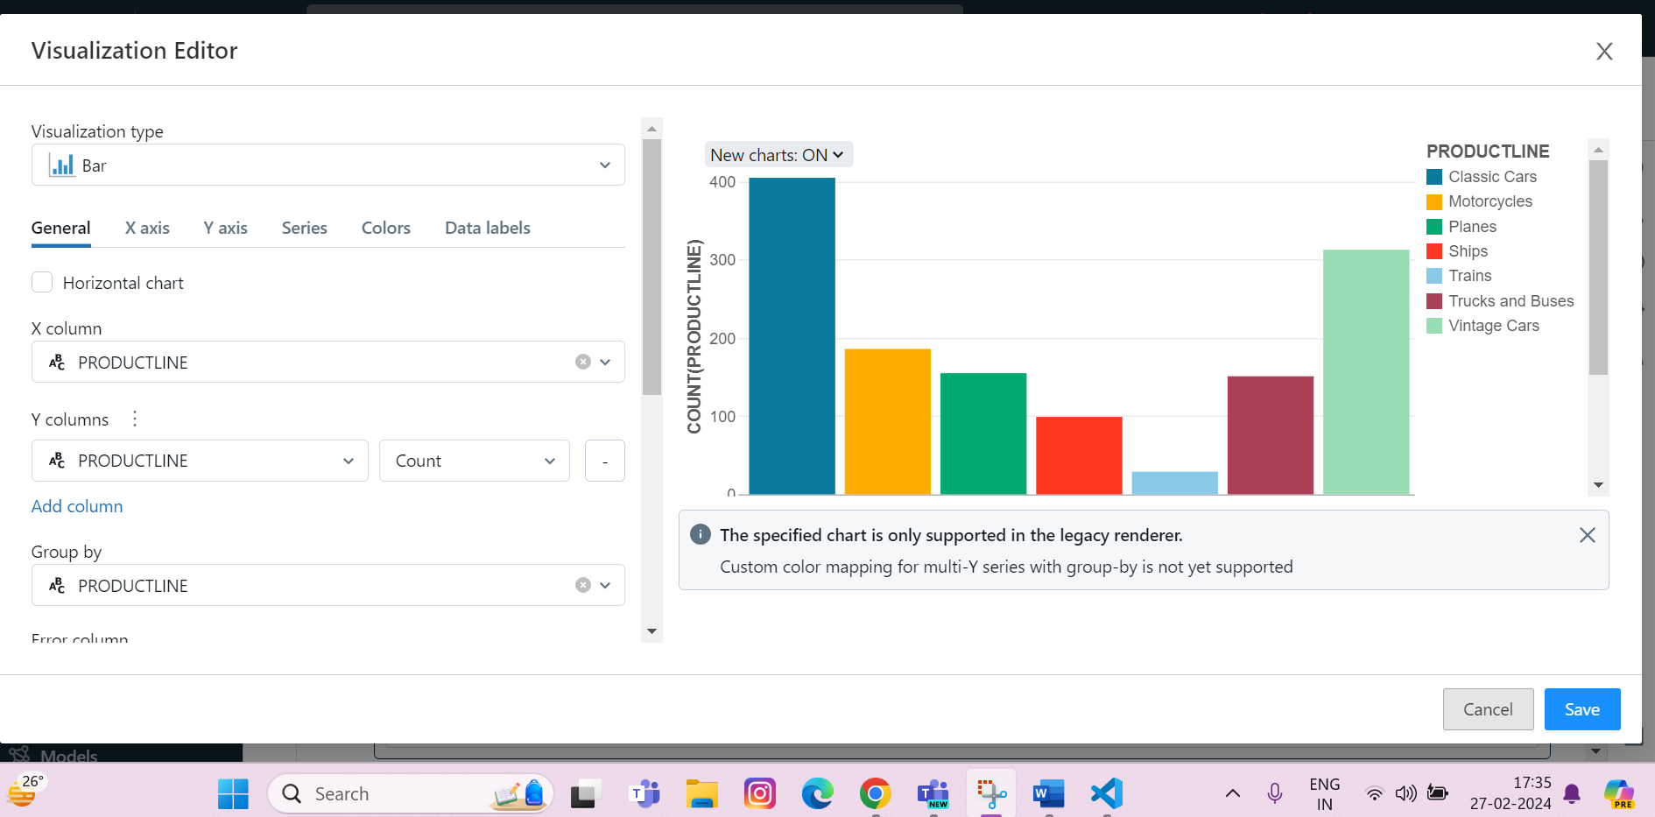
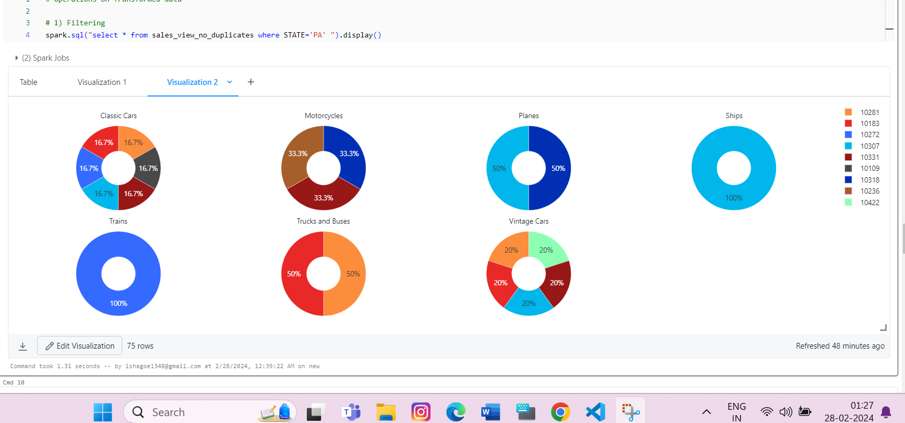
Visualizations
Add some visualizations to have a clear insight to your dataset.

Slide 13
Conclusion
Implementing data analysis with Spark SQL on Azure Databricks enables a seamless and efficient approach to processing and understanding large datasets.
Addressing errors ensures the reliability of insights, while seasonality analysis and anomaly detection contribute to a deeper understanding of data patterns.
This approach provides a comprehensive solution for uncovering insights, improving data quality, and gaining valuable knowledge from the analyzed dataset.
The insights gained from this project can inform strategic decision-making and operational planning for various domains, including retail, finance, healthcare, and more.

Slide 14
THANK YOU

